Slide 1
Credit card default prediction
Swapnil Deshpande (SXD220134)

Slide 2
PREFACE
DATA VISULIZATION
METHODOLOGY
MODELING
OVERVIEW
01
03
Business Problem
Data description
Data Interpretation
Business Insights
02
04
Data Pre-processing
Exploratory Data Analysis
Logistic Regression
Decision Tree
Random Forest Classifier

Slide 3
01. PREFACE

Slide 4
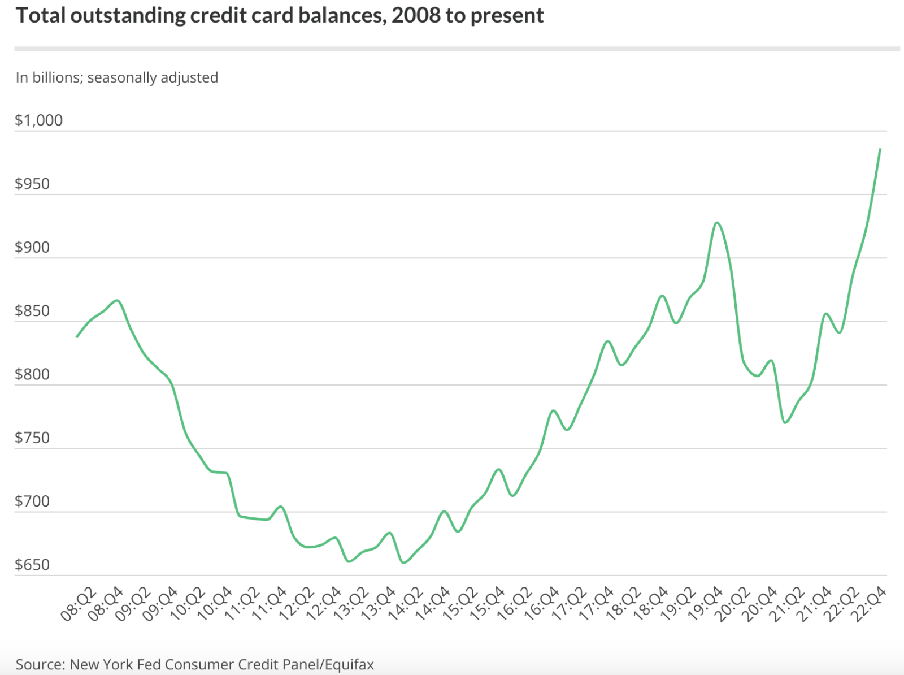
BUSINESS PROBLEM
Banks and Financial Institutions need to maximize returns and minimize bad loans to safeguard financial stability
According to Wells Fargo, the largest U.S. banks can attribute 15% of their revenue to their credit card portfolios
A core growth strategy for banks is to increase the number of consumers who are offered credit, evident from the rising outstanding balances in the graph

Slide 5
BUSINESS PROBLEM
Credit card issuers need to anticipate and reduce risk of default to prevent anticipated loss while entering into new relationships.
The goal of this study is to :
Leverage Machine learning models to quantify probability of a potential applicant defaulting in future
Identify drivers of customer default to better mitigate risk in decision making

Slide 6
DATA DESCRIPTION
Dataset Source https://www.kaggle.com/datasets/rikdifos/credit-card-approval-prediction?resource=download
1,048,575 rows
19 Features
Dataset is obtained by merging two datasets i.e. application_record and credit_record
Contains information about gender, demographic factors, credit record, delinquency data, etc
Feature name | Explanation | Remarks
ID | Client number
CODE_GENDER | Gender | M/F
FLAG_OWN_CAR | Is there a car | Y/N
FLAG_OWN_REALTY | Is there a property | Y/N
CNT_CHILDREN | Number of children
AMT_INCOME_TOTAL | Annual income
NAME_INCOME_TYPE | Income category | Commercial associate, Pensioner, State servant, Student, Working
NAME_EDUCATION_TYPE | Education level | Academic degree, Higher education, Incomplete higher, Lower secondary, Secondary / secondary special
NAME_FAMILY_STATUS | Marital status | Civil marriage, Married, Separated, Widow Single / Not married
NAME_HOUSING_TYPE | Way of living | Co-op apartment, House/Apartment, Municipal apartment, Office apartment Rented apartment, With parents
DAYS_BIRTH | Birthday | Count backwards from current day (0), -1 means yesterday
DAYS_EMPLOYED | Start date of employment | Count backwards from current day(0). If positive, it means the person currently unemployed.
FLAG_MOBIL | Is there a mobile phone | Yes/No
FLAG_WORK_PHONE | Is there a work phone | Yes/No
FLAG_PHONE | Is there a phone | Yes/No
FLAG_EMAIL | Is there an email | Yes/No
OCCUPATION_TYPE | Occupation
CNT_FAM_MEMBERS | Family size
MONTHS_BALANCE | Record month | The month of the extracted data is the starting point, backwards, 0 is the current month, -1 is the previous month, and so on
STATUS | Status | 0: 1-29 days past due 1: 30-59 days past due 2: 60-89 days overdue 3: 90-119 days overdue 4: 120-149 days overdue 5: Overdue or bad debts, write-offs for more than 150 days C: paid off that month X: No loan for the month

Slide 7
02. METHODOLOGY

Slide 8
EXPLORATORY DATA ANALYSIS
Assessment of Data
One hot encoding
Identifying the missing value and replacing with median
Check data imbalance

Slide 9
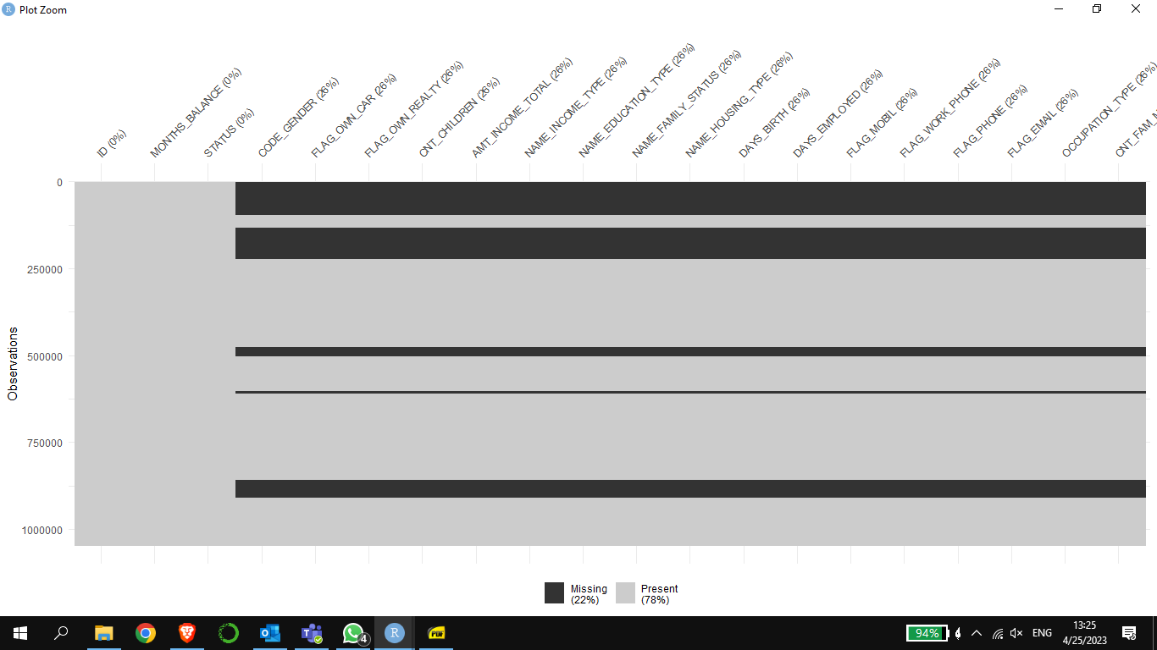
ASSESSMENT OF DATA
Plotting the missing values using the NANIAR package
Inference:
More than quarter of the data contains missing values.
Solution:
Replace the missing values with the median of the respective columns.

Slide 10
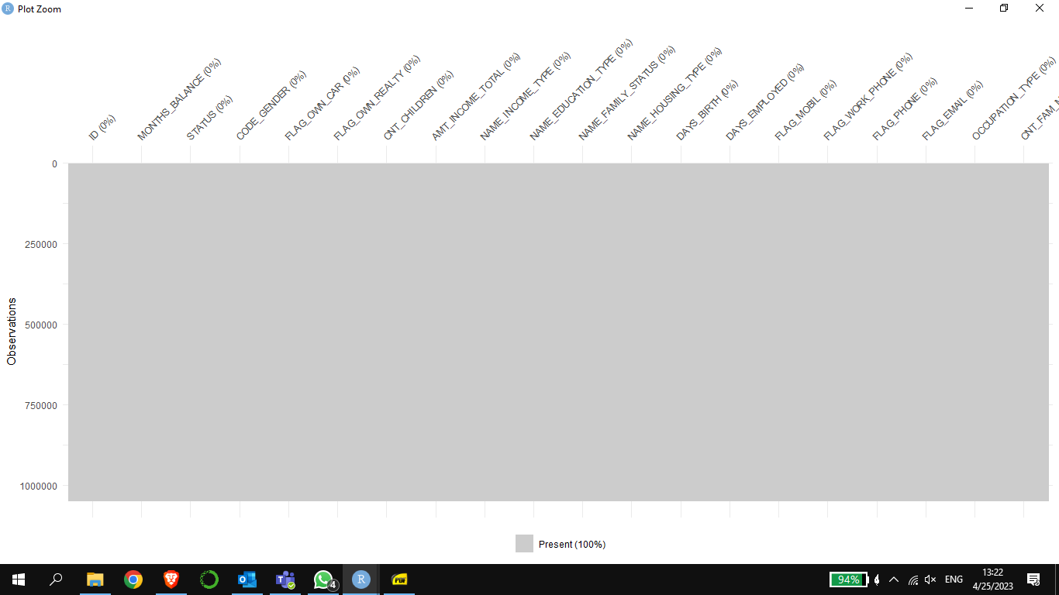
IDENTIFYING THE MISSING VALUES AND REPLACING WITH THE MEDIAN

Slide 11
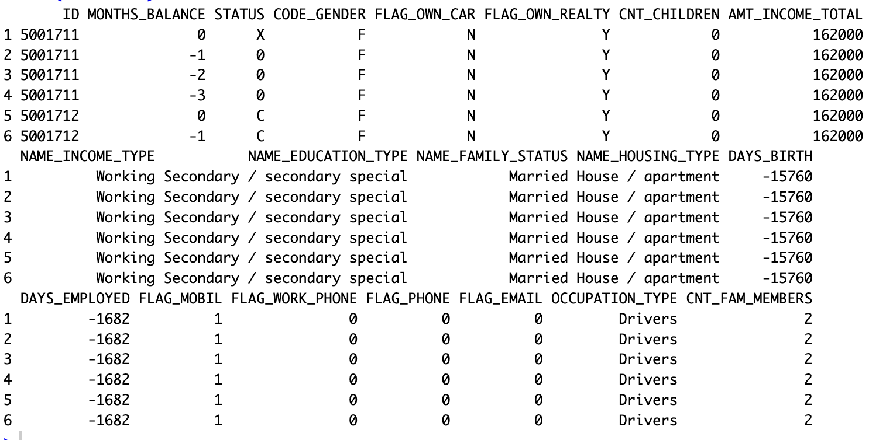
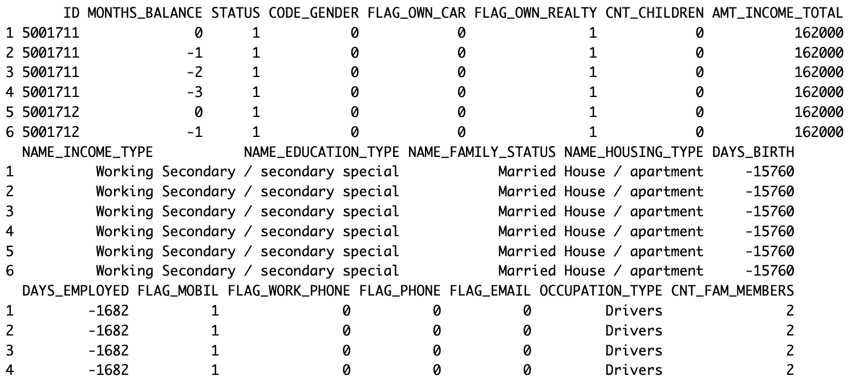
ONE HOT ENCODING
One hot encoding transforms categorical data into numerical - it transforms strings into numbers so that we can apply our Machine Learning algorithms without any problems.

Slide 12
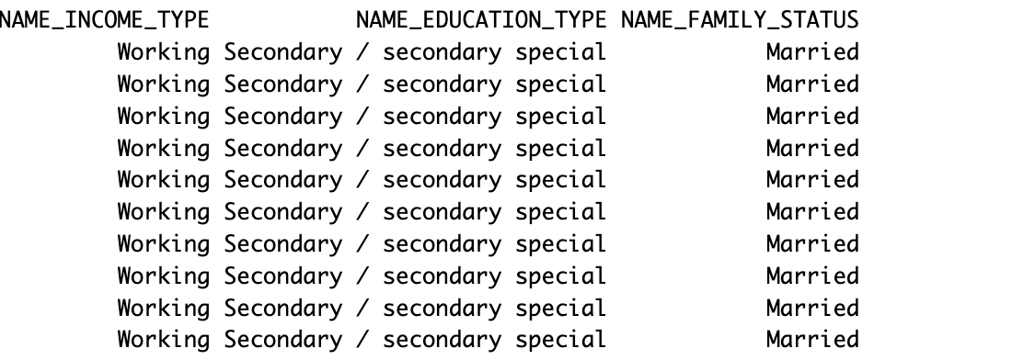
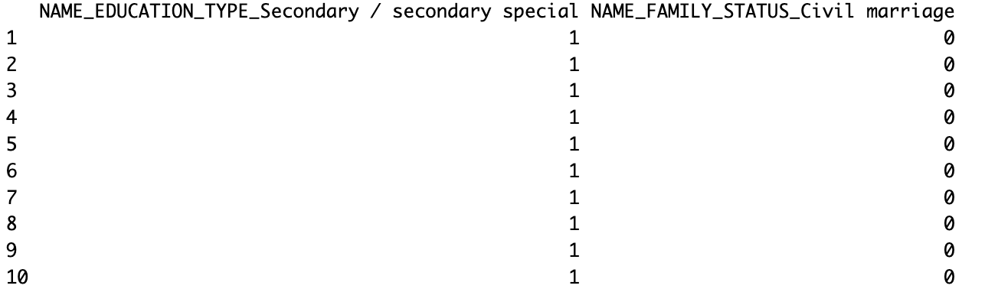
CREATING DUMMY COLUMNS USING FASTDUMMIES PACKAGE
Created dummy columns for NAME_INCOME_TYPE, NAME_EDUCATION_TYPE, NAME_FAMILY_STATUS, NAME_HOUSING_TYPE, OCCUPATION_TYPE
using the fast Dummies package.
This is done for columns with more than two categories.
After the dummy columns are created, the original columns are deleted.

Slide 13
03. DATA VISUALIZATION

Slide 14
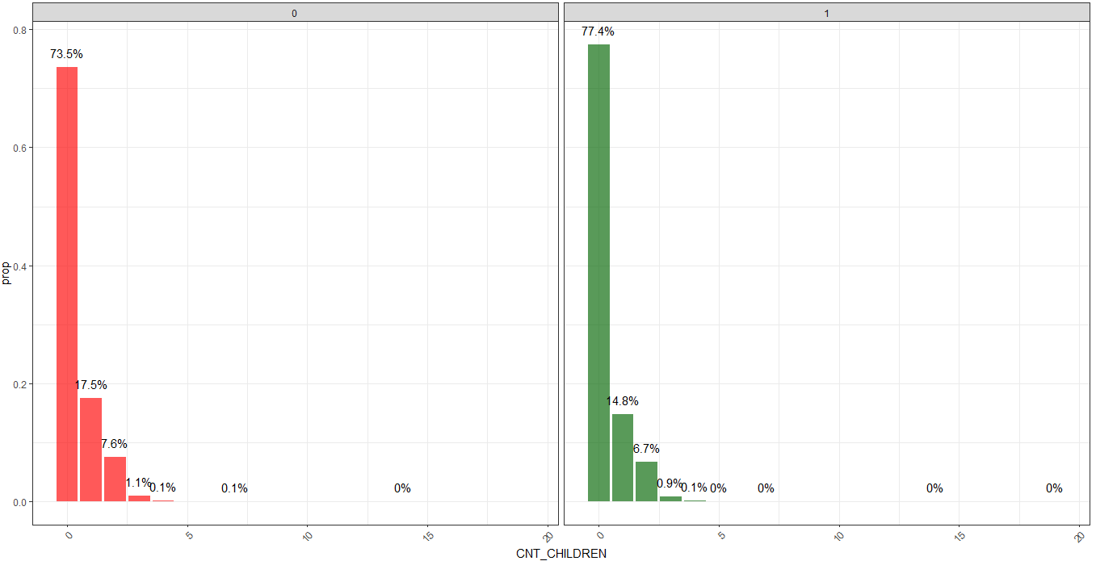
DATA VISUALIZATION
This graph shows the percentage of defaulting and non defaulting customers with respect to their number of children.
The distribution of data between the two graphs appears to be similar.
People with no children are the highest in the dataset.
As we delve into the data, we observe that as the no. of children increases, the no. of defaulters increases slightly.
DEFAULTING
NON-DEFAULTING
Notes:
As we cansssthe distribution of the data appears similar for the defaulting customers and non- defaulting customers
But, it can be seen that the customers with more no of children appears to be default more

Slide 15
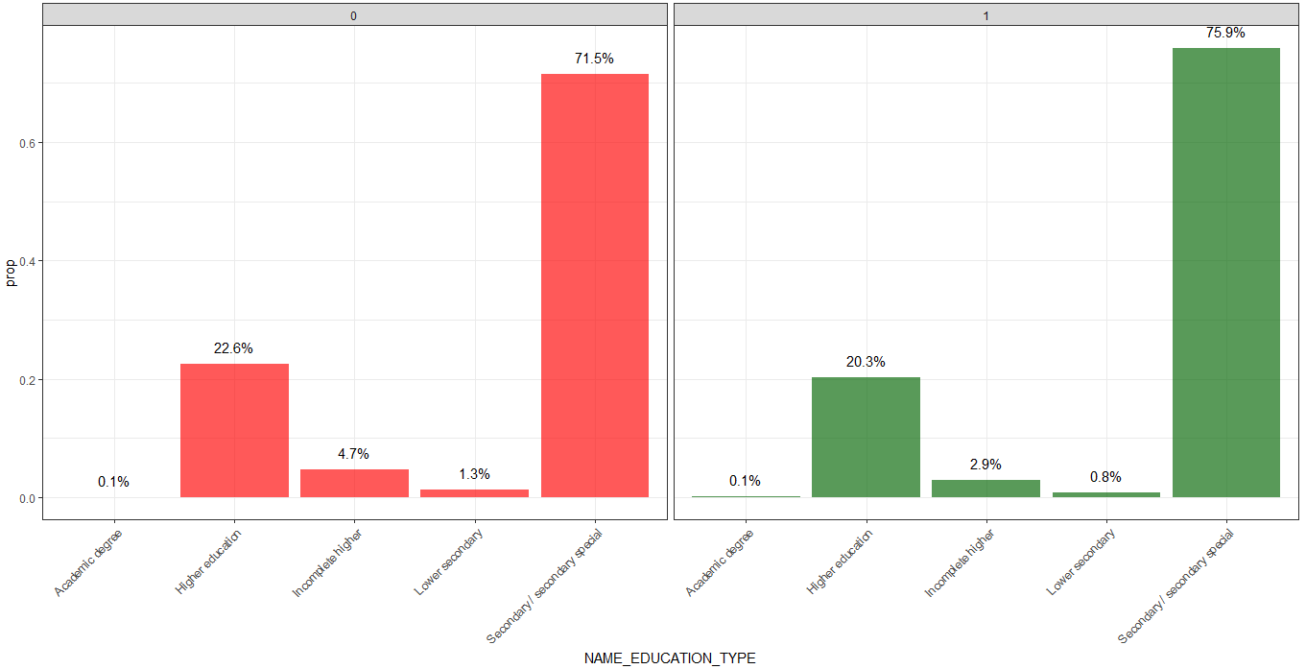
DATA VISUALIZATION
This graph shows the percentage of defaulting and non defaulting customers with respect to their education level
We can observe from the graph that most of the people have the secondary/Secondary special followed by higher education.
DEFAULTING
NON-DEFAULTING
Notes:
Aswe can observe that the people with the

Slide 16
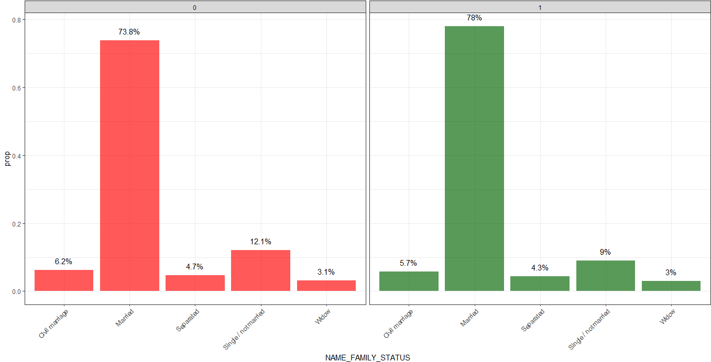
DATA VISUALIZATION
This graph shows the percentage of defaulting and non defaulting customers with respect to their family status.
Highest no. of people who own a credit card are married.
People who are single have a slightly higher percentage to default more.
DEFAULTING
NON-DEFAULTING
Notes:
Distribution is similar in both graphs
Married peoples are the one who mostly own a credit card

Slide 17
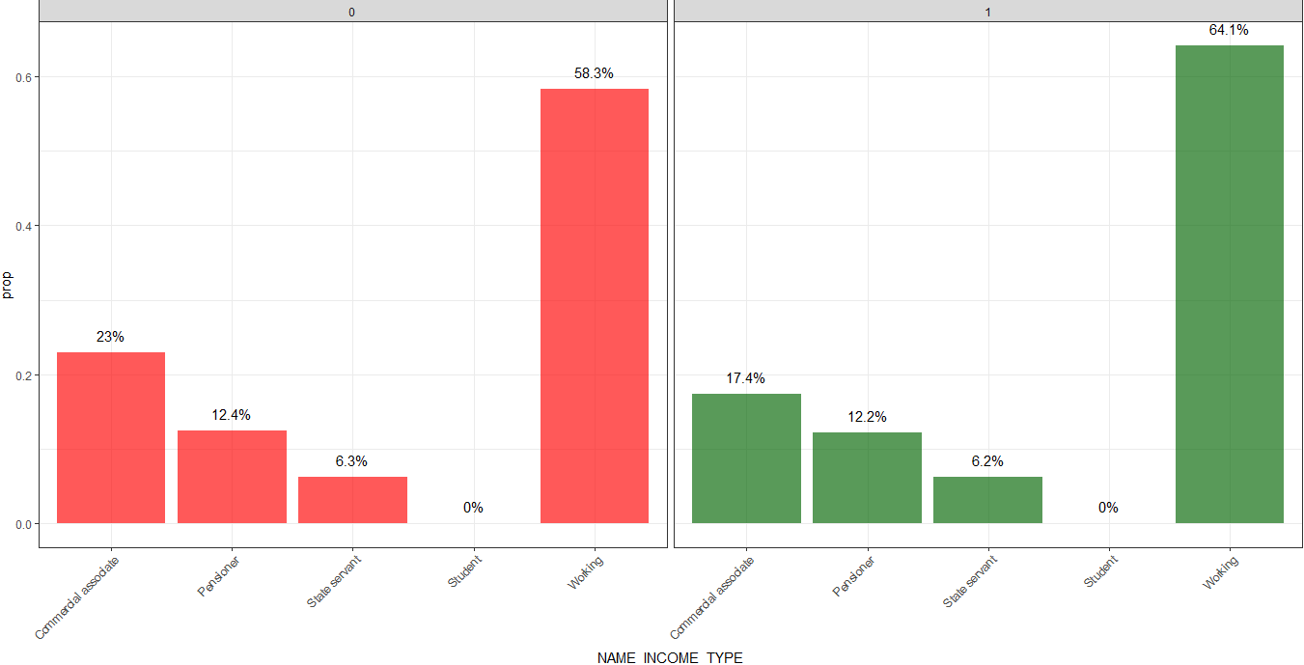
DATA VISUALIZATION
This graph shows the percentage of defaulting and non defaulting customers with respect to their income type.
The people who are working are ones who own the credit cards mostly followed by commercial associate.
People who work tend to default less while in case of commercial associates it the opposite where the default rate is more.
DEFAULTING
NON-DEFAULTING

Slide 18
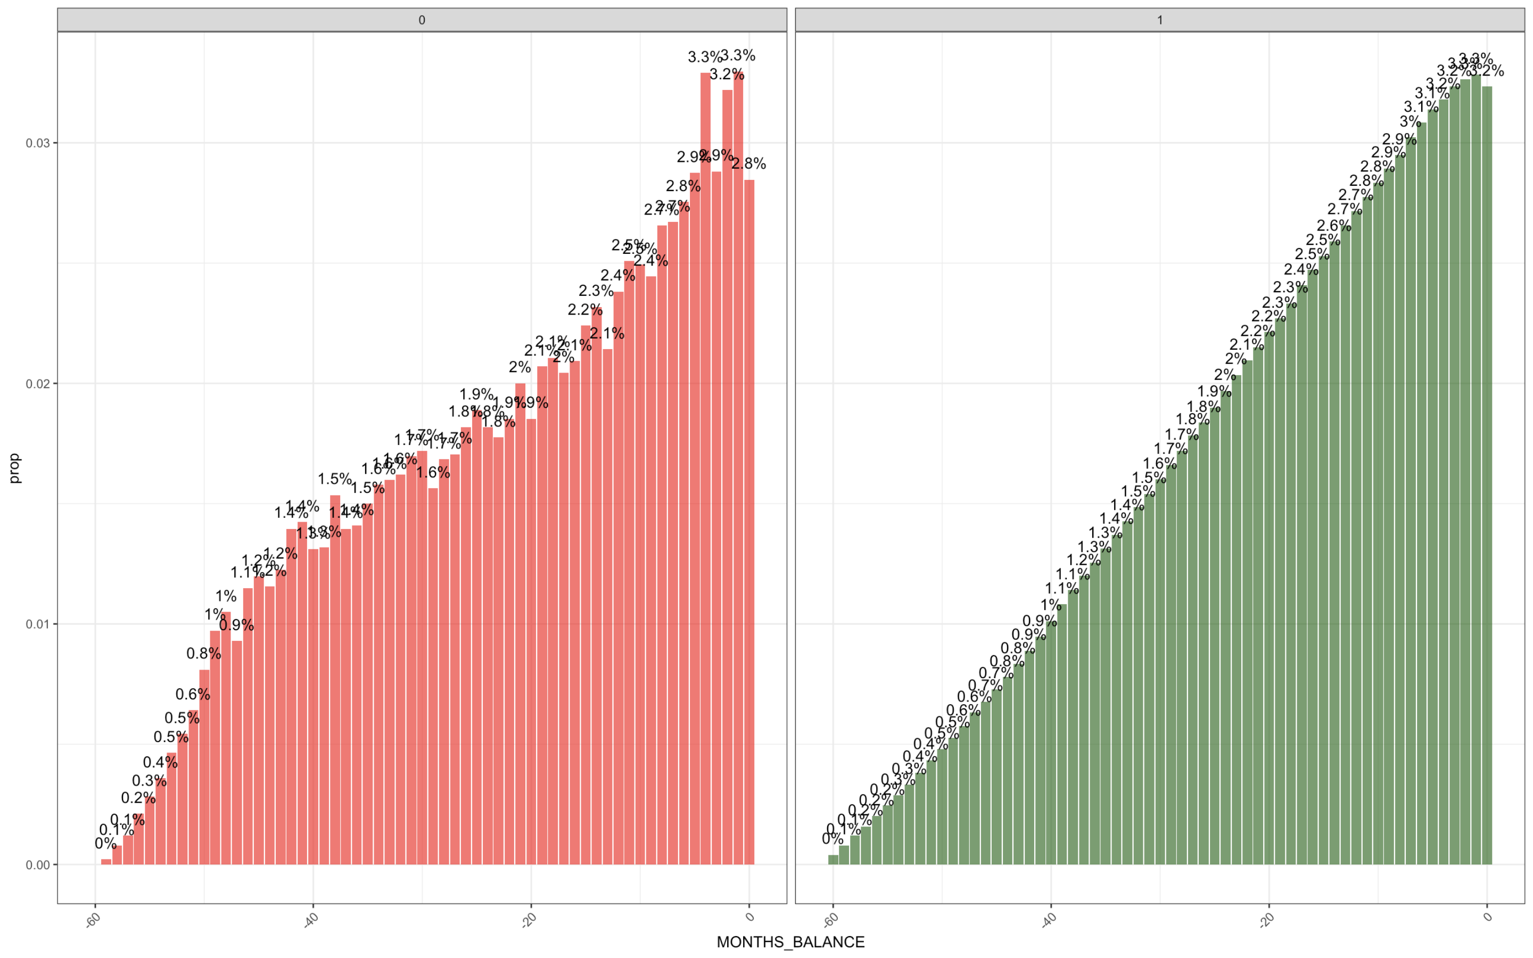
DATA VISUALIZATION
DEFAULTING
NON-DEFAULTING
The graph on the right (non-Defaulters) shows a bell curve distribution.
The data exhibits certain trends that can be observed from the graph on the left.
Hence, we will utilize sophisticated techniques such as random forest to improve our prediction accuracy.

Slide 19
04. MODELING

Slide 20
MODELING TECHNIQUES
Logistic regression
Logistic regression models can help teams identify data anomalies, which are fraud predictors.
Decision tree
Clearly lays out the problem so that all options can be challenged.
Random Forest
The random forest algorithm provides a higher level of accuracy in predicting outcomes over the decision tree algorithm.
Allow us to analyze fully the possible consequences of a decision.
Provide a framework to quantify the values of outcomes and the probabilities of achieving them.

Slide 21
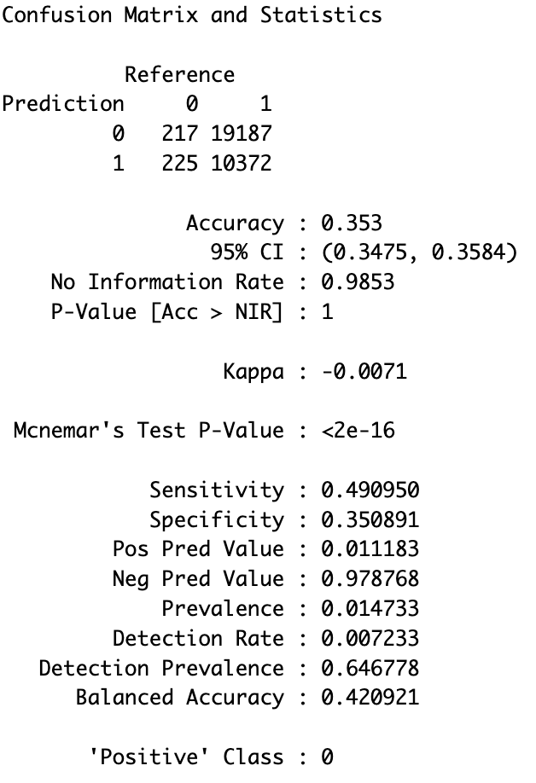
LOGISTIC REGRESSION
The accuracy is 0.353, which indicates that the
model is performing poorly in predicting the
outcome of the dependent variable.
This is not our focus of the analysis since the data is highly imbalanced. So, have applied class weights to the model in order to correct it
More focused on sensitivity i.e. true positives which is about 0.49, which is very low.
Specificity is also very low i.e. 0.35

Slide 22
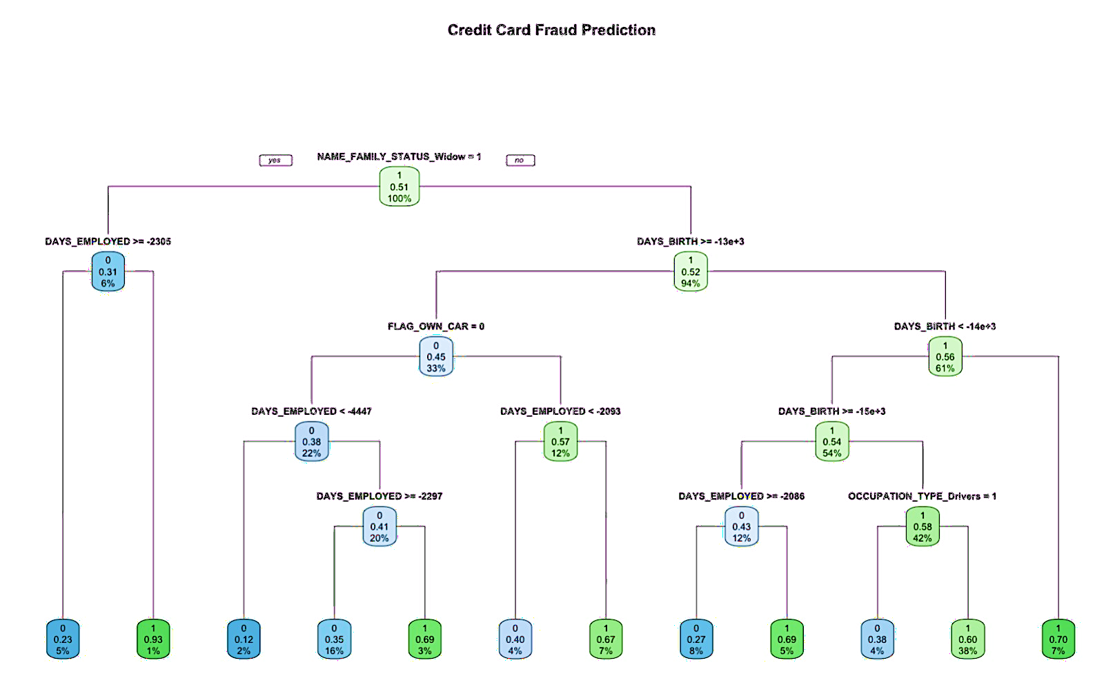
DECISION TREE

Slide 23
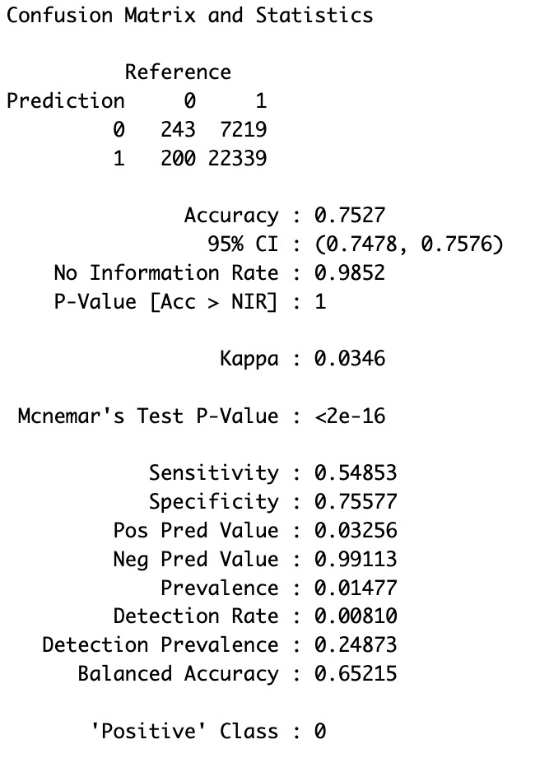
DECISION TREE
It can be observed that the accuracy increases from 0.35 as per logistic regression to 0.75 as per decision tree
As we are focused more on sensitivity, we observe that it increases from 0.49 as per logistic regression to 0.54 as per decision tree, which still low for predictions
Specificity also increases from 0.35 as per logistic regression to 0.75 as per decision tree

Slide 24
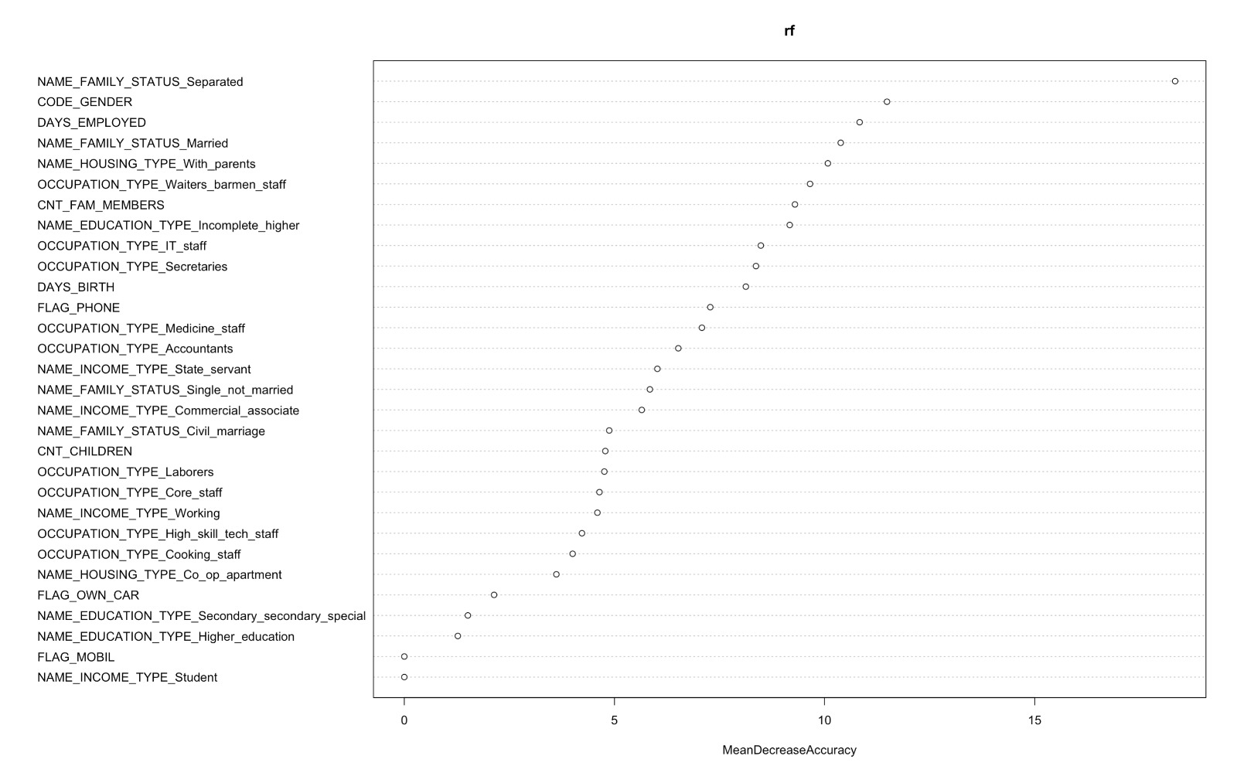
RANDOM FOREST CLASSIFIER
RANDOM FOREST
Random Forest Graph depicts the most important variables used by the model.
The order of importance from top to bottom

Slide 25
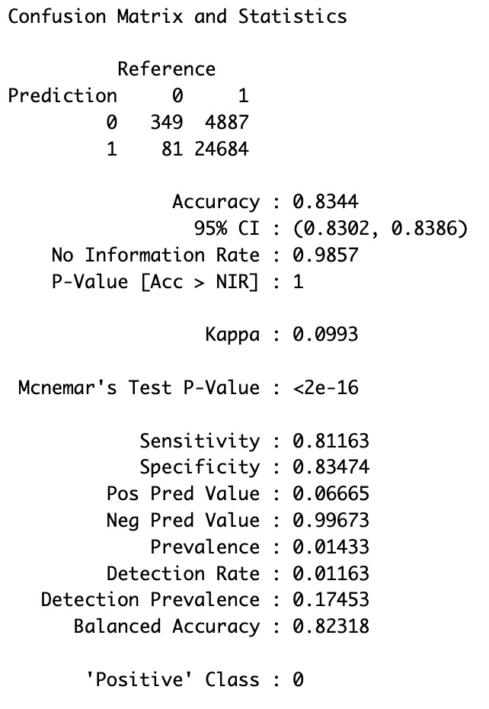
RANDOM FOREST CLASSIFIER
Random Forest Classifier is more sophisticated which is a non-linear bagging technique
As we are focused more on sensitivity, we observe that it increases from 0.54 as per decision tree model to 0.81 as per random forest classifier which signifies that the model is capable of better predictions
Specificity increases from 0.75 as per decision tree to 0.83 as per random forest classifier
Accuracy also increases to 0.83 as per random forest classifier

Slide 26
CONCLUSION
Selected a sample of 100K to train and validate various supervised learning models
Performed Logistic regression , Decision Tree and then applied Random Forest Classifier
Chose the model based on highest sensitivity i.e True Positives as the positive class is 0 as per the R code which signifies that the model should be able to predict higher defaulters vis a vis actual defaulters in the dataset
Random Forest classifier has the Best Sensitivity and Accuracy amongst all models
Model will inform the issuer’s decision on whom to give a credit card to and what credit limit to provide
Model can also be served as an aid in decision making, instead of replacing human decision
Model can be enhanced with more data and computational resources

Slide 27


